Slide 1
Recency
Frequency
Monetary

Slide 2
^{The Segments – Key} ^{Stats}
Key account segments customers (segment 1 & 2) generate well over half of transactions and over 90% of total transaction values.
While middle and lower value customers (over 71% of total customer) generate around 5% of transactions and less than 1% of total transaction values.

Slide 3
^{Strategies}
The main strategy here is how to convert customers from lower/middel value segments to higher value segment via proper campaigns/promotions.
In next section, we’ve developed a unsupervised k-means clustering model to identify those who are more likely to be an aggressive (spend more on one bet) or defensive customers (more likely to increase bets). So that we can provide different offers to lead customers into higher segments through two ways (spend stretch, bets stretch).
Bets stretch
Spend stretch
 | Average Spend Bands
Bets Bands | <=$20 | $21 to $45 | $46 to $100 | $101 to $290 | $291 to $1000 | >$1000
<= 2 bets | 9. Try person |  |  | 8. Event focused player
3 to 9 bets | 7. Casual entertainer |  |  | 6. Frequent gambler
10 to 50 bets
51 to 100 bets | 5. Opportunism |  | 4. Strategy driven gambler |  | 3. Professional gambler
101 to 500 bets
> 500 bets | 2. Small casual groups |  |  | 1. Large gambling group / business

Slide 4
Key Account |  | High Value |  | Mid Value |  | Low Value
Recency
The BetFair RFM model has been built over 3 months period.
 | Average Spend Bands
Bets Bands | <=$20 | $21 to $45 | $46 to $100 | $101 to $290 | $291 to $1000 | >$1000
<= 2 bets | 9. Try person |  |  | 8. Event focused player
3 to 9 bets | 7. Casual entertainer |  |  | 6. Frequent gambler
10 to 50 bets
51 to 100 bets | 5. Opportunism |  | 4. Strategy driven gambler |  | 3. Professional gambler
101 to 500 bets
> 500 bets | 2. Small casual groups |  |  | 1. Large gambling group / business
Frequency
Number of bets over 3 months (grouped into 6 bands based on distribution of data).
Monetary
Average Transaction Value (ATV) over the 3 months (grouped into 6 bands based on distribution of data.)

Slide 5
Unsupervised Clustering

Slide 6
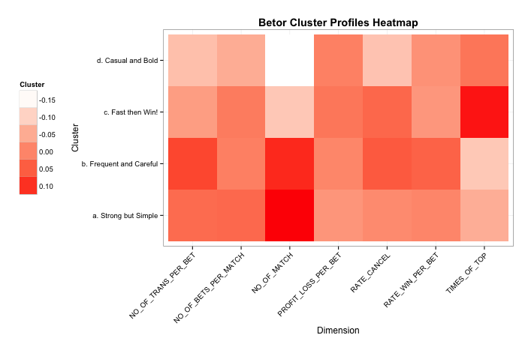
^{The Clusters}
As an extension towards the RFM model, an unsupervised clustering model (Kmeans) was used to further group the customers from a betting behavioral perspective. It combines with the RFM segmentations to support a more comprehensive and flexible marketing strategy.

Slide 7
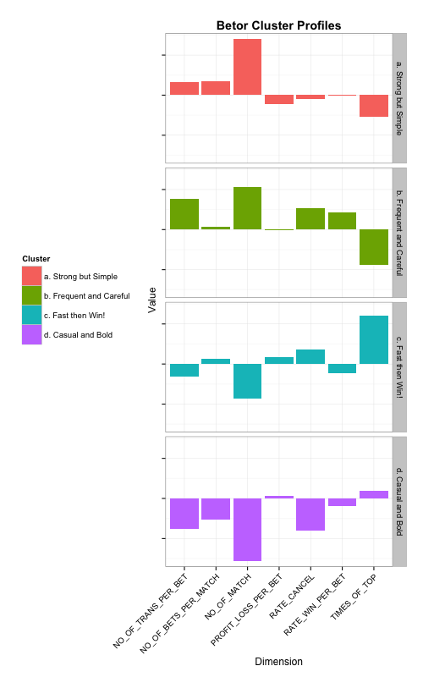
A. Strong but Simple: Bet more and diversely, but does not have a good outcome
B. Frequent and Care: Bet frequently, but cancel a lot
C. Fast then Win!: Bet less and early, but wins a lot
D. Casual and Bold: No strategy, just casually play
Gut Findings from the Clusters Profiles
Those who placed the bet early and focus on smaller number of bets seem to gain more profit than others
Those who put more transactions into a single bet and carefully considering cancelling offers, turns out to have a higher win rate than others
More bets do not mean more win/profit

Slide 8
^{Example}
Send right customers the right offer to increase ROI and minimize campaign / offer costs
Bets stretch
(towards RFM segment 7)
 | Average Spend Bands
Bets Bands | <=$20 | $21 to $45 | $46 to $100 | $101 to $290 | $291 to $1000 | >$1000
<= 2 bets | 9. Try person |  |  | 8. Event focused player
3 to 9 bets | 7. Casual entertainer |  |  | 6. Frequent gambler
10 to 50 bets
51 to 100 bets | 5. Opportunism |  | 4. Strategy driven gambler |  | 3. Professional gambler
101 to 500 bets
> 500 bets | 2. Small casual groups |  |  | 1. Large gambling group / business
Spend stretch
(towards RFM segment 8)

